Slide 1
How to Navigate the DCM LAB Animal Resource System (LARS) Accounts/Invoices and Report Functions

Slide 2
Items for Review
Log into LARS
Animal Use Protocols
Account/Invoice Management
Reports

Slide 3
How to Log into LARS
Using Chrome or Firefox enter the LARS URL lars.dcm.utoronto.ca
Enter your UTOR ID
Enter your password
Click on “Log In”
Land on the LARS eAnimal Ordering Page

Slide 4
Animal Use Protocol Information

Slide 5
Notes:
Clicking on either get approved protocols or investigator home will take you to the investigator home page.

Slide 6
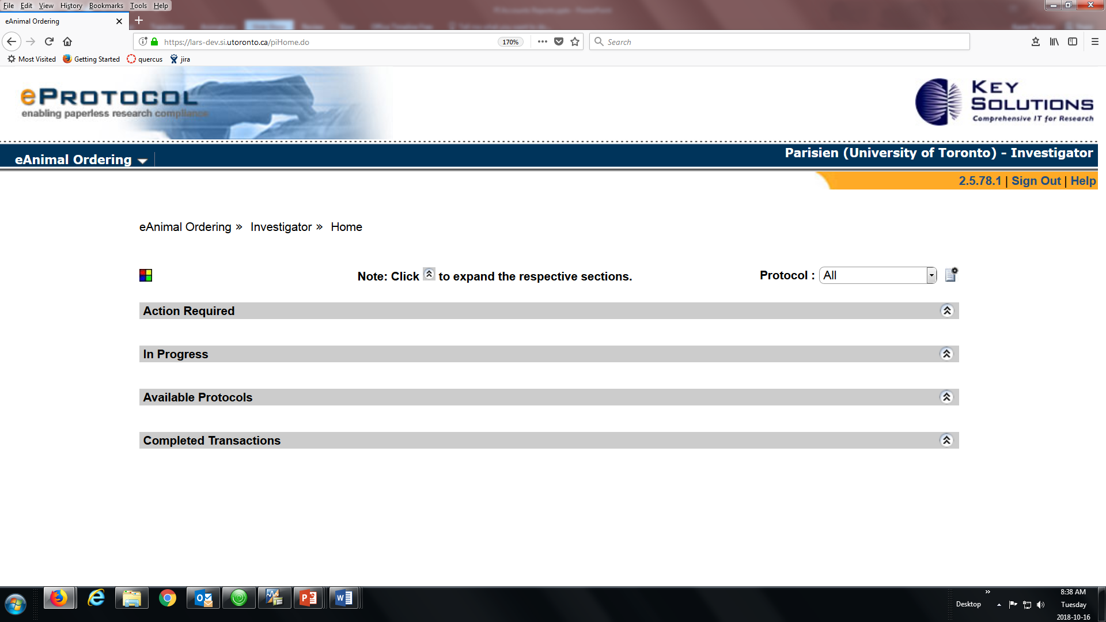
Notes:
There are 4 sections on the home page including a list of your available protocols.

Slide 7
Notes:
When you open the protocol list on your home page there is additional information available to you. Some protocols may be highlighted. In this case the pink colour reflects the fact that you have used 80% of your quota for this animal use protocol.

Slide 8
Notes:
If you click on any protocol in your list of available protocols it can show you some additional detail about the protocol. When you click on a protocol it take syou to the approved species page.

Slide 9
Notes:
If you click on the protocol number again a pop up appears that provides some information about animal numbers approved and remaining and also some information about the approval history for this protocol.

Slide 10
Notes:
If you click on list of protocols in the investigator menu it takes you to a complete list of your protocols.

Slide 11
Notes:
The protocols listed on this page include currently approved protocols as well as expired protocols

Slide 13
Funding (Account) Management
Notes:
You can attach any account to any number of protocols and if you desire use a % of multiple accounts to for animal purchases

Slide 14
Notes:
Relates to per diems generated over a statement period

Slide 15
Notes:
Care days

Slide 16
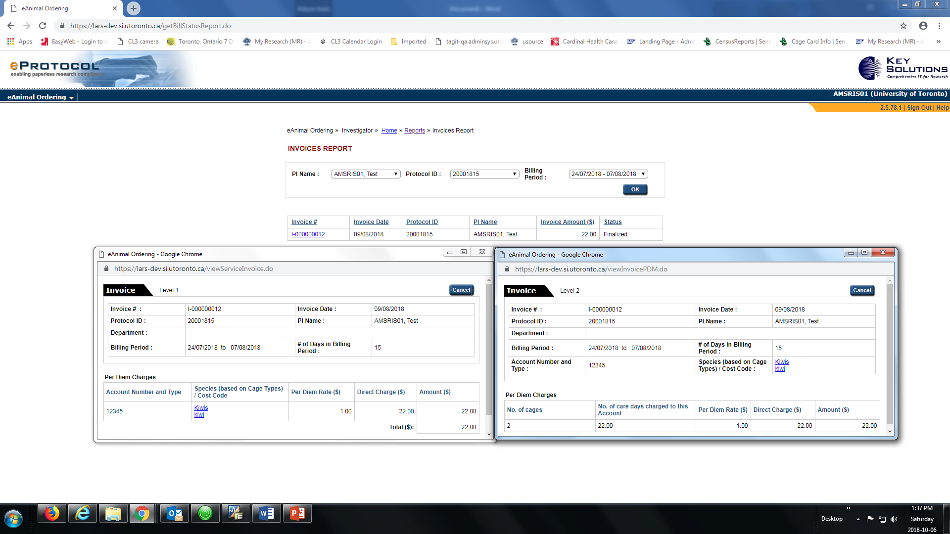

Slide 18
Notes:
Any animal purchases made during the billing period for each account
Purchase charges for each account number you have during a billing period

Slide 23
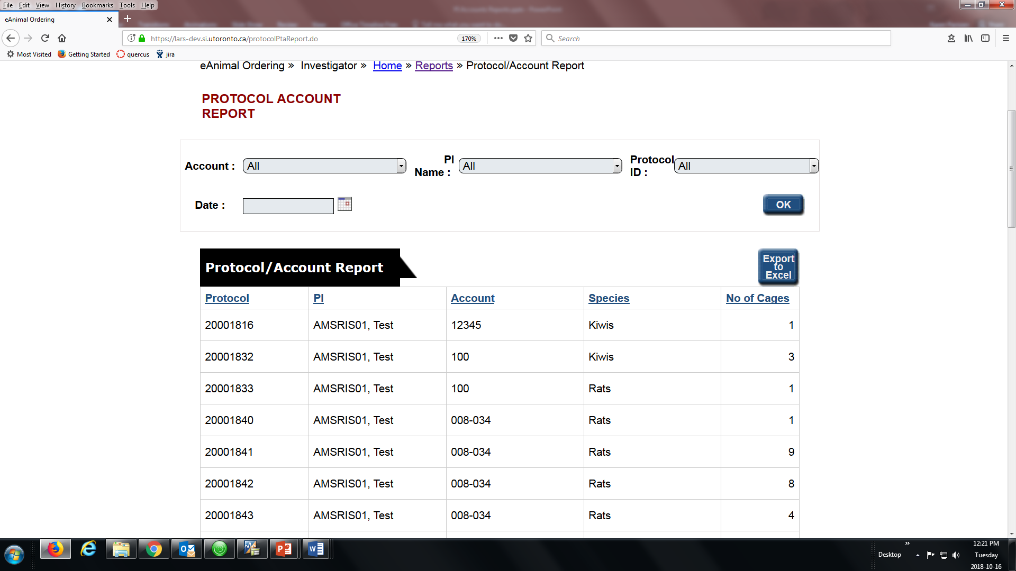
Notes:
Protocol/account report – can quickly see the accounts related to each protocol and the . Can search by protocol or account to have an easy reference to the species on that account and the number of cages currently on hand for the date that you chose.

Slide 24
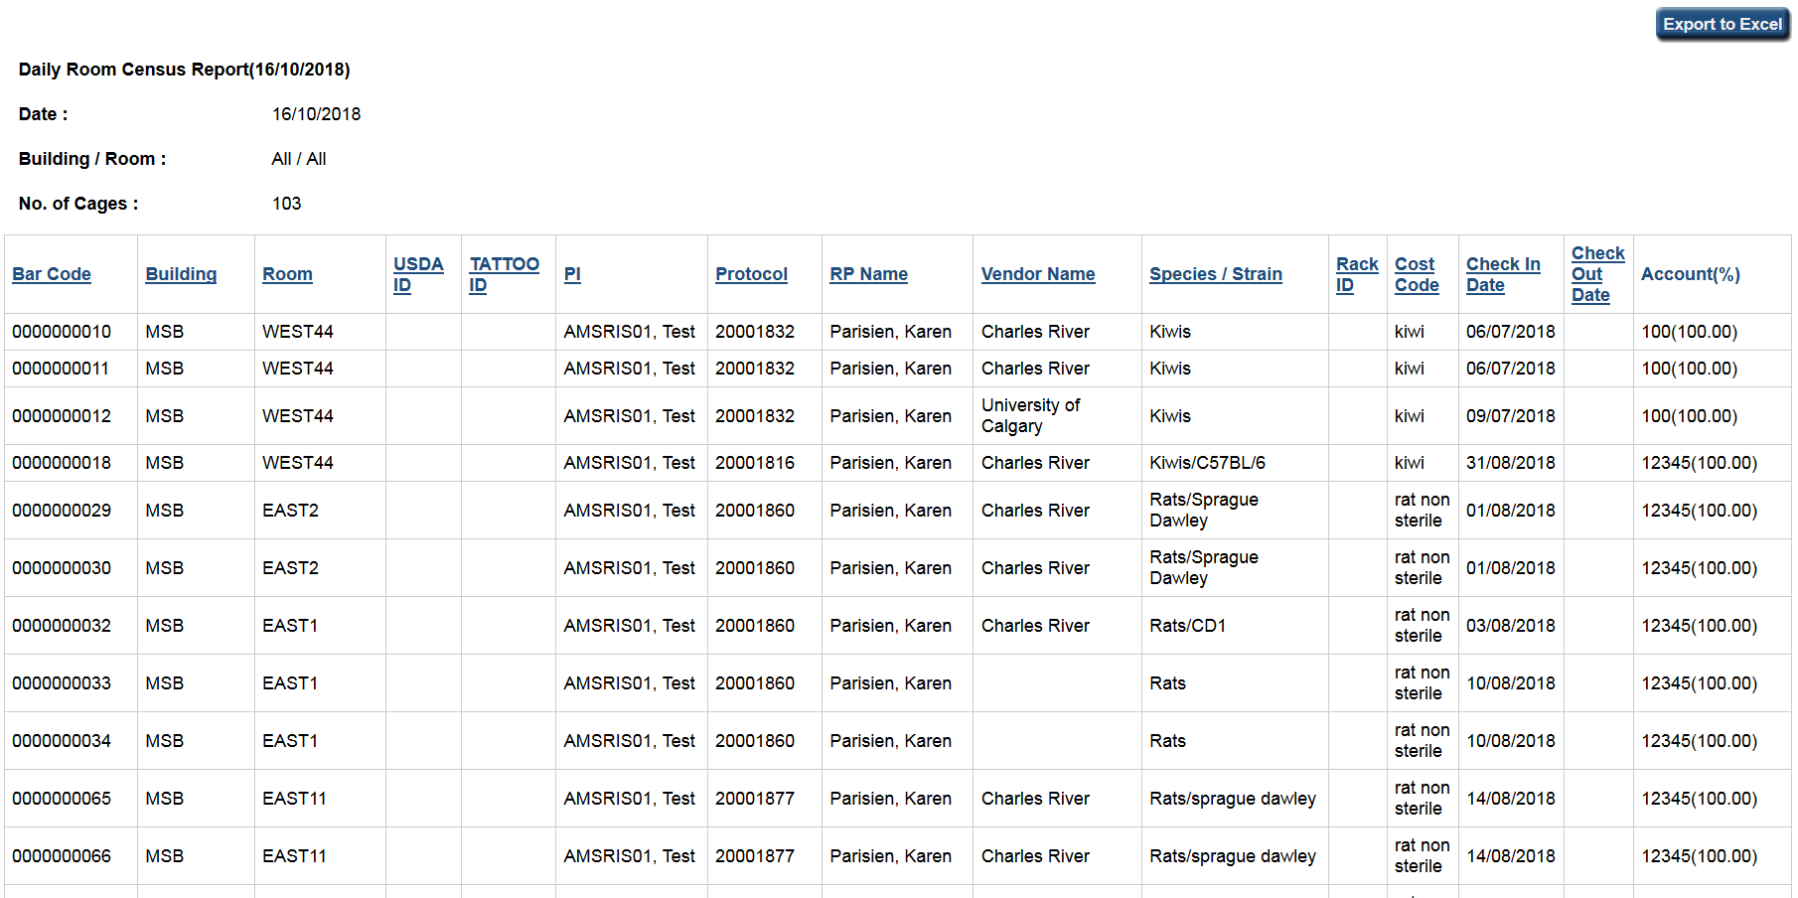
Notes:
Check the census for each room on a particular day by bar code. Provides complete information regarding purchase infor and account info

Slide 25
Notes:
For specific protocols gives you details about requisitions and orders. You can open up each requisition or order to obtain more information regarding each.

Slide 27
dcm.utoronto.ca

Slide 30
For animals being exported to another University use the external transfer.
For animal being imported from another University use the animal requisition.

Slide 31
dcm.utoronto.ca

Slide 36
PI or Procurement Staff
Split wean request is submitted
PI
Places stickers on cage of wean/splits
Fills in log sheet with activation date, source barcode,
Procurement Staff
Transcribes info from Log sheet to LARS
Saves info to activate new bar codes
Procurement Staff
Approves split/wean request
Prints Log Sheet & stickers and provides to PI
Prints cage cards to replace stickers

Slide 38
Wi-Com Sensus
Utilizes RFID tags embedded in cage card stock
Manages check-in, check-out of animal cages with RFID tag or bar code
Census of cages using wireless technology & hand held RFID scanner

Slide 39
Wi-Com Sensus
Show a picture of the cage card, show bar code, rfid tag embedded in the cage card
9 digit order number
Differences in the new system, daily census, animal numbers
Everything funnels from AUP

Slide 41
Data Migration
What we know for sure
a. >95 % of animal numbers posted in MRAP don’t match up with inventory on hand
b. Currently almost 9,000 cages of mice
c. More than 50% of the cages in DCM do not have an AUP number on the cage card.
d. There is a % of protocols that are expired and still have animals on hand

